Slide 1
The Fundamental Rights of India

Slide 2
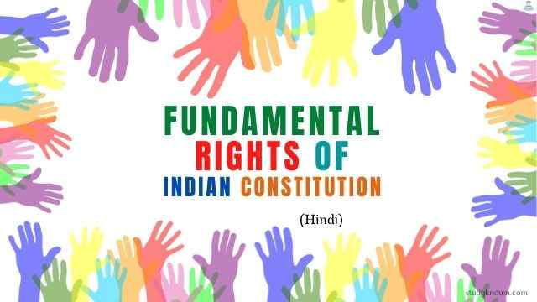

Slide 3
Introduction:
Fundamental rights are those rights which are essential for intellectual, moral and spiritual development of citizens of India. As these rights are fundamental or essential for existence and all-round development of individuals, they are called 'Fundamental rights'. These are enshrined in Part III (Articles 12 to 35) of the Constitution of India.

Slide 4
Six fundamental rights were originally provided by the Constitution,
· they are the right to equality,
· right to freedom,
· right against exploitation
· right to freedom of religion,
· cultural and educational rights and
· right to constitutional remedies Anurag Malik

Slide 5
Today, let us start the presentation with Right to Equality.
The general principle of equality and non-discrimination is a fundamental element of International Human Rights Law. Thus, the right to equal treatment requires that all persons be treated equally before the law, without discrimination. The Indian Constitution is no different.

Slide 6
Right to Equality
Article 14 to 18 of the Constitution deals with this fundamental right.
The types of equality are:
Natural
Social
Civil
Political
Economic
Legal
The Right to Equality is one of the Fundamental Rights enshrined in the Constitution of India

Slide 7
A brief description on the articles are given below:
Article 14:
The State shall not deny to any person equality before the law or the equal protection of the laws within the territory of India, on grounds of religion, race, caste, gender or place of birth
Article 15:
The State shall not discriminate against any citizen on grounds only of religion, race, caste, gender, place of birth or any of them respect to:
Access to public places
Use of tanks, wells, ghats, etc. that are maintained by the State or that are meant for the general public
· The article also mentions that special provision can be made for women, children and the backward classes notwithstanding this article.
Article 16:
There shall be equality of opportunity for all citizens in matters relating to employment or appointment to any office under the State.

Slide 8
Article 17:
Abolition of untouchability:
· Untouchability is abolished in all forms.
Any disability arising out of untouchability is made an offence.
Article 18:
Abolition of all titles except military and academic;
Awards like Padma Shri, Padma Bhushan, Padma Vibhushan, Bharat Ratna and military honours like Ashok Chakra, Param Vir Chakra do not belong to this category.
-Debarghya Barik

Slide 9
Right To Freedom:
The Constitution of India contains the right to freedom, given in articles 19, 20, 21A, and 22, and with the view of guaranteeing individual rights.
•Freedom of speech and expression, on which the State can impose reasonable restrictions in the interests of the sovereignty and integrity of India, the security of the State, friendly relations with foreign States, public order, decency or morality or in relation to contempt of court, defamation or incitement to an offence.

Slide 10
•Freedom to assemble peacefully without arms, on which the State can impose reasonable restrictions in the interest of public order and the sovereignty and integrity of India.
•Freedom to form companies or unions or co-operative societies on which the State can impose reasonable restrictions in the interest of public order, morality and the sovereignty and integrity of India.
•Citizens have the freedom to move freely throughout India, although reasonable restrictions can be imposed on this right in the public's interest, such as to control an epidemic, restrictions on movement and travel can be imposed.
Article 20: gives protection in respect of conviction for offences.
Article 21: gives the right to life, personal liberty and the right to die with dignity (passive euthanasia).
Article 22: Protection against arrest and detention in certain cases.
-Shreyas R

Slide 11
Right to Constitutional Remedies:
The Right to Constitutional Remedies empowers citizens to approach the Supreme Court of India to seek enforcement, or protection against infringement, of their Fundamental Rights. It includes article 32 that provides a guaranteed remedy, in the form of a Fundamental Right itself, for enforcement of all the other Fundamental Rights, and the Supreme Court is designated as the protector of these rights by the Constitution. The Supreme Court has been empowered to issue writs, namely habeas corpus, mandamus, prohibition, certiorari and quo warranto, for the enforcement of the Fundamental Rights, while the High Courts have been empowered under Article 226 – which is not a Fundamental Right in itself – to issue these prerogative writs even in cases not involving the violation of Fundamental Rights. The Supreme Court has the jurisdiction to enforce the Fundamental Rights even against private bodies, and in case of any violation, award compensation as well to the affected individual. Exercise of jurisdiction by the Supreme Court can also be suo motu or on the basis of public interest litigation. This right cannot be suspended, except under the provisions of Article 359 when a state of emergency is declared. - Akash Kallai

Slide 12
Cultural and Educational Rights:
The Cultural and educational Rights preserve the right of any section of citizens to conserve their culture, language or script, and right of minorities to establish and administer educational institutions of their choice.
2. The Constitution guarantees every single citizen of India both rights to education and cultures. The Constitution also provides special measures, to protect the rights of the minorities. Any community that has a language and a script of its own has the right to conserve and develop it. No citizen can be discriminated against for admission in the state or state-aided institutions.
All minorities, religious or linguistic, can set up their own educational institutions to preserve and develop their own culture. In granting aid to institutions, the state cannot discriminate against any institution on the basis of the fact that it is administered by a minority institution. The right to administer does not mean that the state cannot interfere in case of maladministration.

Slide 13
(3)In a precedent-setting judgment in 1980, the Supreme Court held that the state can take regulatory measures to promote the efficiency and excellence of educational standards. It can also issue guidelines for ensuring the security of the services of the teachers or other employees of the institution. In another judgment delivered on 31 October 2002, the Supreme Court ruled that in case of aided minority institutions offering professional courses, admission could be only through a common entrance test conducted by State or a university. Even an unaided minority institution ought not to ignore the merit of the students for admission.[
- Dhruva Bhattacharya

Slide 14
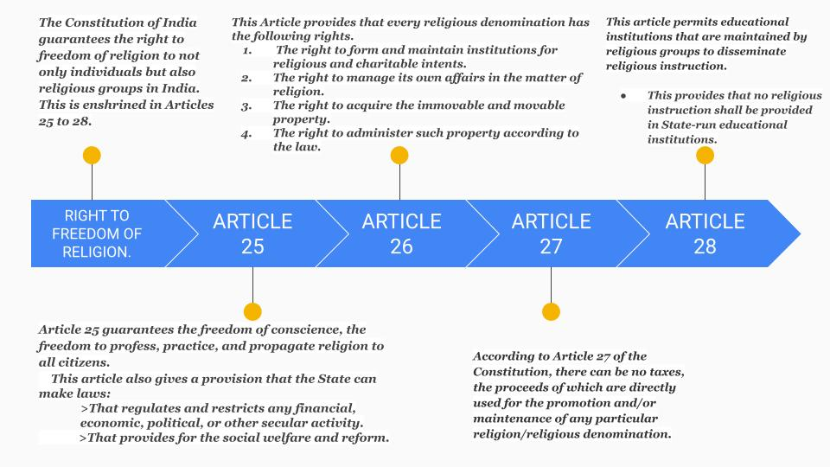

Slide 15
Right Against Exploitation:
The right against exploitation, given in Articles 23 and 24, provides for two provisions, namely the abolition of trafficking in human beings and Begar (forced labour), and the abolition of employment of children below the age of 14 years in dangerous jobs like factories, mines, etc. Child labour is considered a gross violation of the spirit and provisions of the constitution. Begar, practised in the past by landlords, has been declared a crime and is punishable by law. Human trafficking for the purpose of the slave trade or prostitution is also prohibited by law. An exception is made in employment without payment for compulsory services for public purposes. Compulsory military conscription is covered by this provision.
-Jyoti Raj

Slide 16
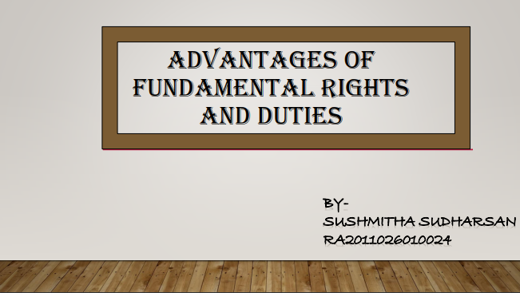

Slide 17


Slide 18
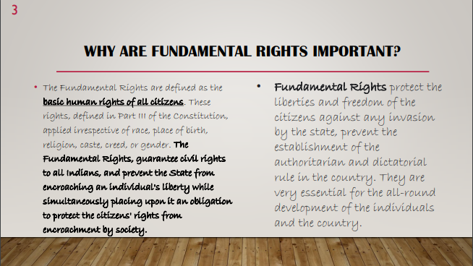

Slide 19
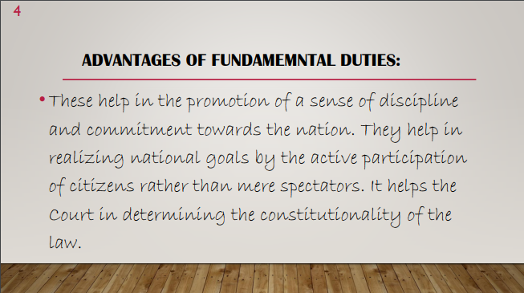

Slide 20
Presentation Done By:
Introduction - Anurag Malik (RA2011026010030)
Right to Equality - Debarghya Barik (RA2011026010022)
Right to Freedom of Speech - Shreyas R (RA2011026010029)
Right to Constitutional Remedies - Akash Kallai (RA2011026010021)
Cultural and Educational Rights - Dhruva Bhattacharya (RA2011026010023)
Rights to Freedom of Religion - Achal Kamboj (RA2011026010028)
Rights Against Exploitation - Jyoti Raj Sinha (RA2011026010025)
Advantages of Fundamental Rights - Sushmitha Sudharsan(RA2011026010024)
Edited by : So Called Engineers Gang Team

